Slide 1
Practical on Information Security (BTCS06001)
By
Prof. Pranita Binnar (Research Scholar, Ph.D. Pursuing)
Visiting Faculty, Dept. of Computer Engineering
NMIMS, Navi Mumbai Campus

Slide 2
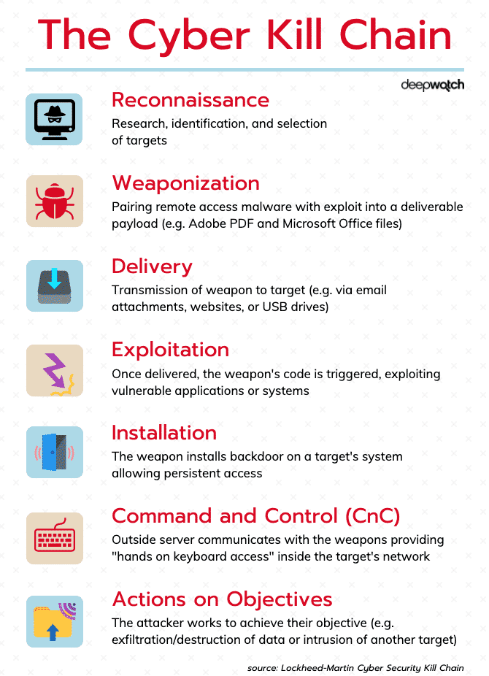
Aim – To Study of Cyber Kill Chain Framework for any Critical Infrastructure Cyber Attack

Slide 3
Critical Infrastructure Areas
Telecommunications
Electrical power systems
Water supply systems
Gas and oil pipelines
Transportation
Government services
Banking and finance
Nuclear Power Plant

